Slide 1
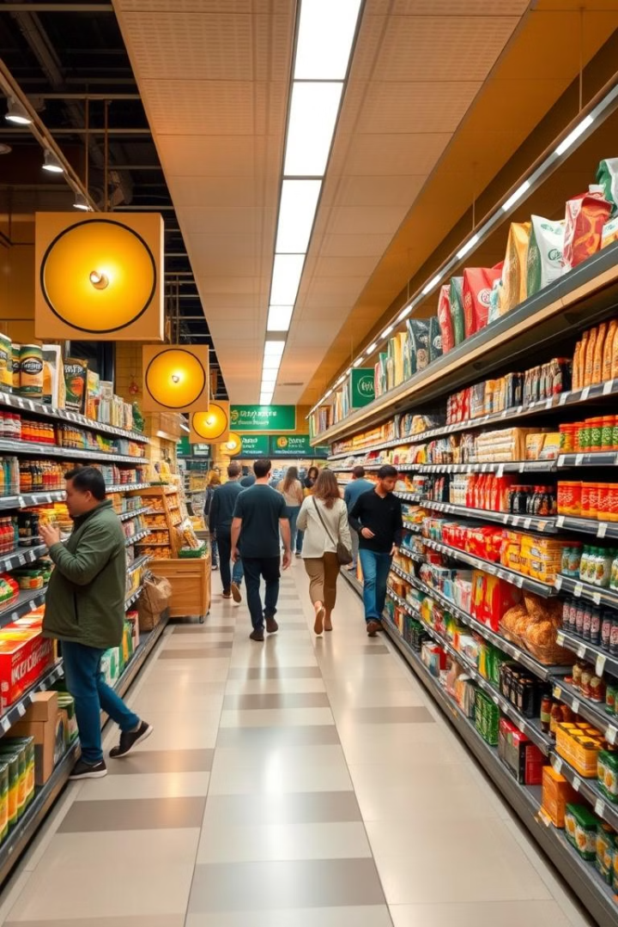

Super Market Sales Dashboard
Proposal to boost sales and customer experience.
by Nitish Kumar

Slide 2
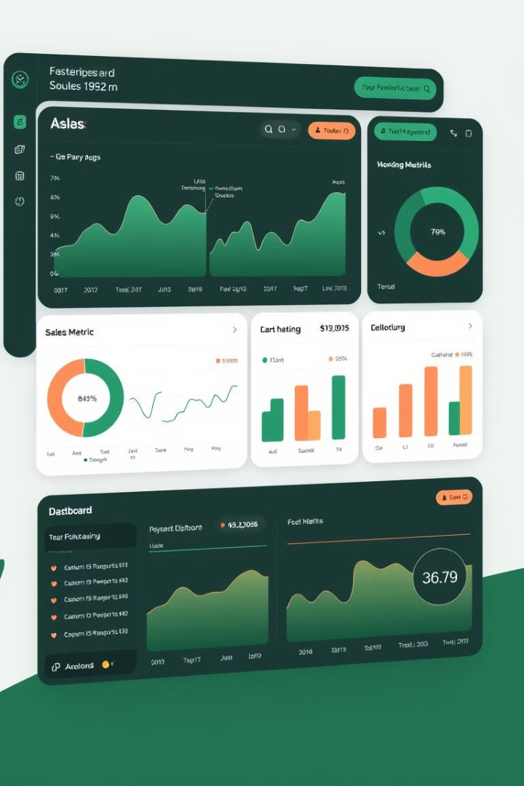
Key Objectives
1
Increase Revenue
Increase sales revenue by X%.
2
Customer Retention
Improve customer satisfaction.
3
Optimize Inventory
Reduce waste.
4
Targeted Marketing
Boost product visibility.

Slide 3
Sales Strategy: Pricing
Pricing Optimization
Promotional Campaigns
Dynamic pricing strategies.
Targeted promotions.

Slide 4
Sales Strategy: Placement
Product Placement
Customer Experience
Strategic merchandising.
Enhanced engagement.

Slide 5




Implementation Plan: Phase 1
Market Research
Develop Strategies
Execute Campaigns
Competitor analysis.
Promotional strategies.
Optimize pricing.

Slide 6

Implementation Plan: Phase 2
Monitor Performance
Refine approach.

Slide 7

Expected Outcomes
Increased Traffic
Revenue Growth
Higher engagement.
Higher conversion rates.
Brand Loyalty
Repeat purchases.

Slide 8

Conclusion
Data-driven strategy for growth.
Customer-centric approach for success.

